Slide 1
Chapter 3
Transport Layer
TCP - RTT Estimation

Slide 2


TCP round trip time, timeout
Q: how to set TCP timeout value?
longer than RTT, but RTT varies!
too short: premature timeout, unnecessary retransmissions
too long: slow reaction to segment loss
Q: how to estimate RTT?
SampleRTT:measured time from segment transmission until ACK receipt
  ignore retransmissions
SampleRTT will vary, want estimated RTT “smoother”
  average several recent measurements, not just current SampleRTT

Slide 3
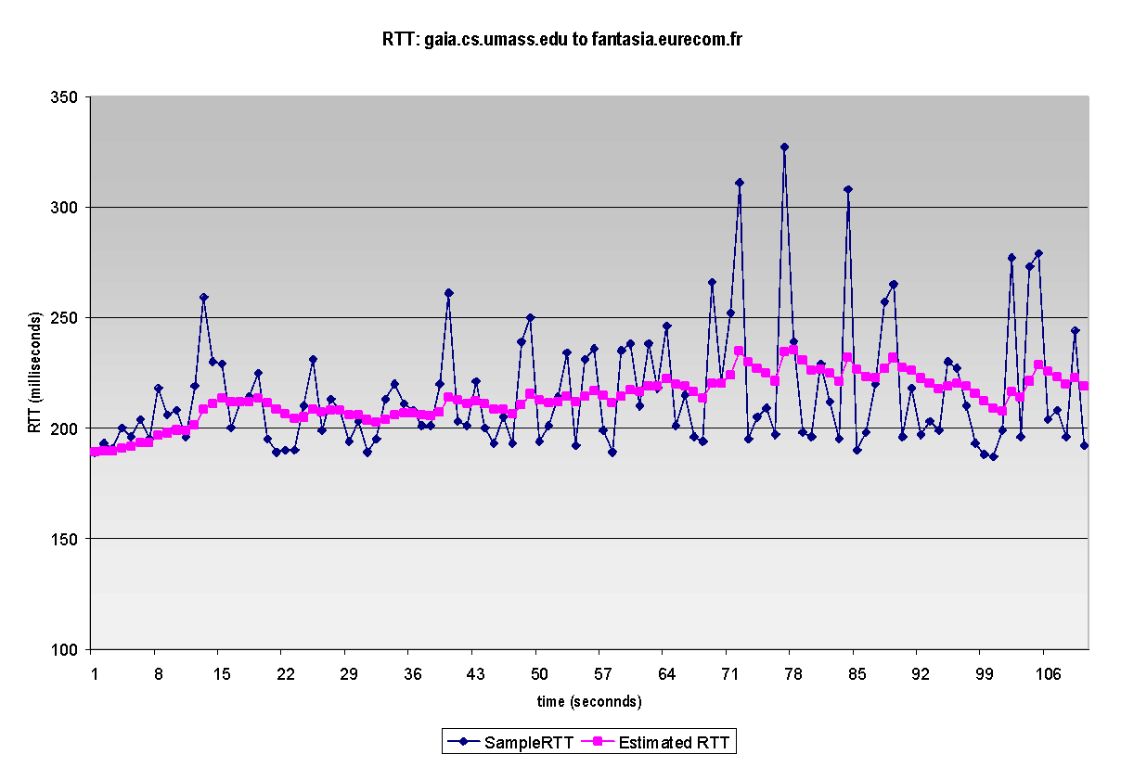
TCP round trip time, timeout
EstimatedRTT = (1- α)*EstimatedRTT + α*SampleRTT
exponential weighted moving average (EWMA)
influence of past sample decreases exponentially fast
typical value: α = 0.125
RTT: gaia.cs.umass.edu to fantasia.eurecom.fr
RTT (milliseconds)
sampleRTT
EstimatedRTT
time (seconds)
Notes:
This is how TCP re-computes the estimated RTT each time a new SampleRTT is taken.
The process is knows as an exponentially weighted moving average, shown by the equation here.
<say it>
Where alpha reflects the influence of the most recent measurements on the estimated RTT; a typical value of alpha used in implementations is .125
The graph at the bottom show measured RTTs between a host in the Massachusetts and a host in France, as well as the estimated, “smoothed” RTT

Slide 4





TCP round trip time, timeout
timeout interval: EstimatedRTT plus “safety margin”
  large variation in EstimatedRTT: want a larger safety margin
TimeoutInterval = EstimatedRTT + 4*DevRTT
estimated RTT
“safety margin”
DevRTT: EWMA of SampleRTT deviation from EstimatedRTT:
DevRTT = (1-β)*DevRTT + β*|SampleRTT-EstimatedRTT|
(typically, β = 0.25)
* Check out the online interactive exercises for more examples: http://gaia.cs.umass.edu/kurose_ross/interactive/
Notes:
Given this value of the estimated RTT, TCP computes the timeout interval to be the estimated RTT plus a “safety margin”
And the intuition is that if we are seeing a large variation in SAMPLERTT – the RTT estimates are fluctuating a lot - then we’ll want a larger safety margin
So TCP computes the Timeout interval to be the Estimated RTT plus 4 times a measure of deviation in the RTT.
The deviation in the RTT is computed as the eWMA of the difference between the most recently measured SampleRTT from the Estimated RTT

Slide 5
15-10 TCP TIMERS
To perform its operation smoothly, most TCP implementations use at least four timers as shown in Figure 15.38 (slide 83).
TCP/IP Protocol Suite
5
Notes:
5

Slide 6
Topics Discussed in the Section
Retransmission Timer
Persistence Timer
Keepalive Timer
TIME-WAIT Timer
TCP/IP Protocol Suite
6
Notes:
6

Slide 7
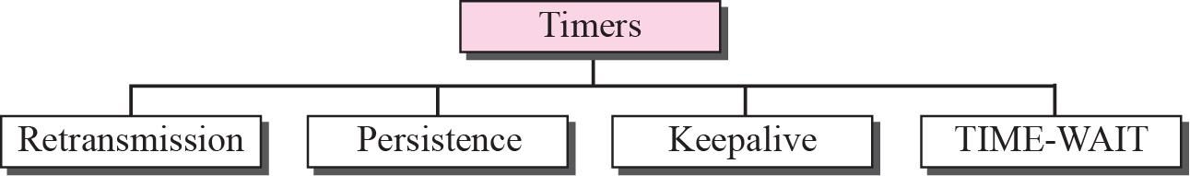
Figure 15.38 TCP timers
TCP/IP Protocol Suite
7
Notes:
7

Slide 8

Retransmission timer
if an ACK is received before the timer goes off – destroy or reset the timer
if the timer goes off before ACK arrives – retransmit the segment & reset the timer
How to set Retransmission time
  longer than RTT
    but RTT varies since paths that IP packets take may differ
  if too short
    Premature timeout –> retransmissions -> waste of bandwidth
  if too large
    slow reaction to segment loss
    delay for the application program

Slide 9

Note
In TCP, there can be only one RTT measurement in progress at any time.
Since the segments and their ACKs do not have a 1-1 relationship
TCP/IP Protocol Suite
9
Notes:
9

Slide 10





Calculation of RTO (1)
Smoothed RTT: RTT_{S} (EstimatedRTT)
  Original 🡪 No value
  After 1st measurement 🡪 RTT_{S} = RTT_{M}
  2nd … 🡪 RTT_{S} = (1-α)*RTT_{S} + α*RTT_{M}
TCP/IP Protocol Suite
10

Slide 11



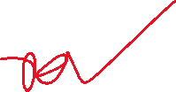
Calculation of RTO (2)
RTT Deviation : RTT_{D} (DevRTT)
  Original 🡪 No value
  After 1st measurement 🡪 RTT_{D} = 0.5*RTT_{M}
  2nd … 🡪 RTT_{D} = (1-β)*RTT_{D} + β*|RTT_{S} - RTT_{M}|
TCP/IP Protocol Suite
11

Slide 12
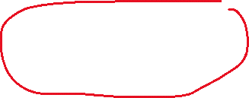
Calculation of RTO (3)
Retransmission Timeout (RTO)
  Original 🡪 Initial value
  After any measurement
  🡪 RTO = RTT_{S} + 4RTT_{D}
Example 10 (page 322)
  α = ⅛ = 0.125
  β = ¼ = 0.25
TCP/IP Protocol Suite
12

Slide 13
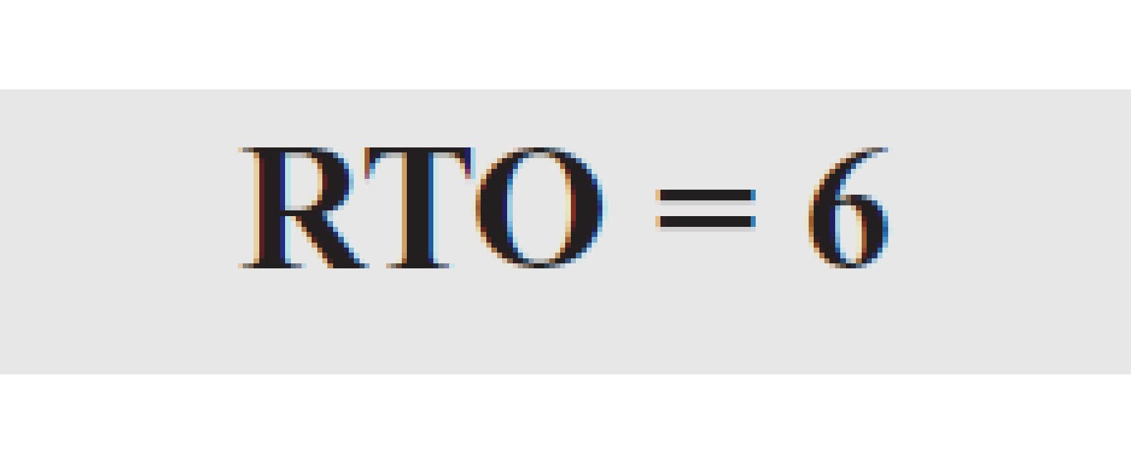
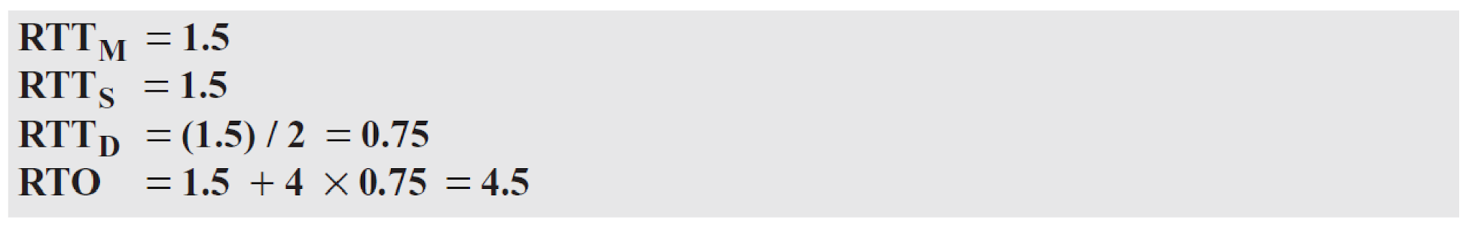





Example 15.3
Let us give a hypothetical example. Figure 15.39 shows part of a connection. The figure shows the connection establishment and part of the data transfer phases.
1. When the SYN segment is sent, there is no value for RTTM, RTTS, or RTTD. The value of RTO is set to 6.00 seconds. The following shows the value of these variable at this moment:
2. When the SYN+ACK segment arrives, RTT_{M} is measured and is equal to 1.5 seconds.
TCP/IP Protocol Suite
13
Notes:
13

Slide 14
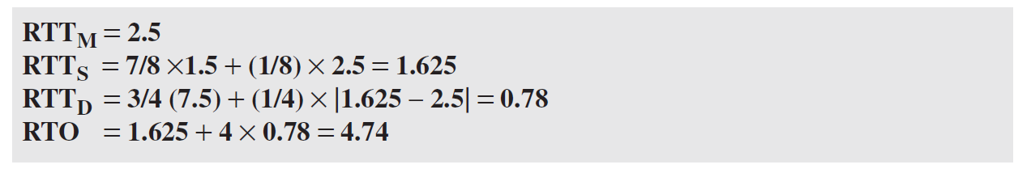



Example 15.3 Continued
3. When the first data segment is sent, a new RTT measurement starts. No RTT measurement starts for the second data segment because a measurement is already in progress. The arrival of the last ACK segment is used to calculate the next value of RTTM. Although the last ACK segment acknowledges both data segments (cumulative), its arrival finalizes the value of RTTM for the first segment. The values of these variables are now as shown below.
TCP/IP Protocol Suite
14
Notes:
14

Slide 15
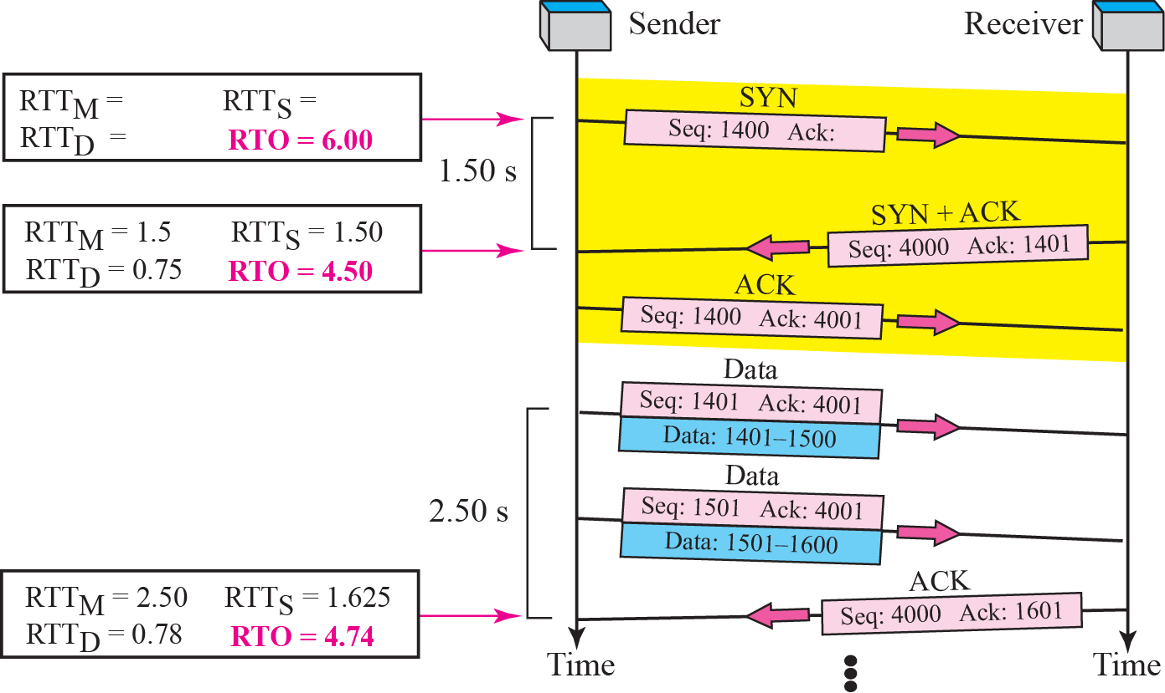





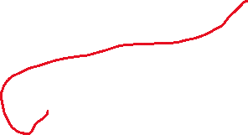




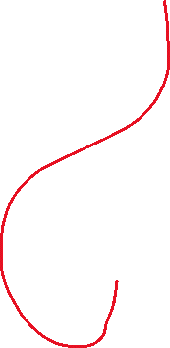
Figure 15.39 Example 15.3
TCP/IP Protocol Suite
15
Notes:
15

Slide 16
Figure 15.39 Example 15.3
Until a round-trip time (RTT) measurement has been made for a segment sent between the sender and receiver, the sender SHOULD set RTO = 1 second.
Reference: https://www.rfc-editor.org/info/rfc6298/#section-2
TCP/IP Protocol Suite
16
Notes:
16

Slide 17
Figure 15.39 Example 15.3
Steps:
First Measurement:
RTT_{S} = RTT_{M}
RTT_{D} = 0.5 * RTT_{M}
TCP/IP Protocol Suite
17
Notes:
17

Slide 18
Figure 15.39 Example 15.3
Steps:
All Other Measurement:
RTT_{M} = Latest measurement of RTT
Calculate RTT_{S} = (1-α)*RTT_{S} + α*RTT_{M}
Calculate RTT_{D} = (1-β)*RTT_{D} + β*|RTT_{S} - RTT_{M}|
Finally Calculate RTO = RTT_{S} + 4RTT_{D}
Here,
α = 0.125
β = 0.25
TCP/IP Protocol Suite
18
Notes:
18

Slide 19
Note
TCP does not consider the RTT of a retransmitted segment in its
calculation of a new RTO.
TCP/IP Protocol Suite
19
Notes:
19

Slide 20
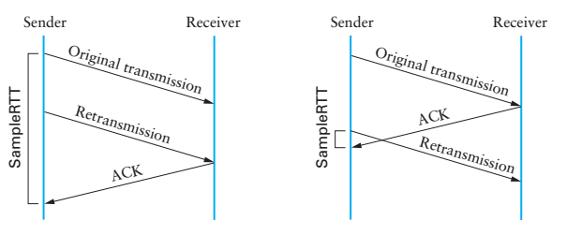
Flaw in RTO Calculation
Karn/Partridge Algorithm
Doesn’t include retransmitted packet

Slide 21
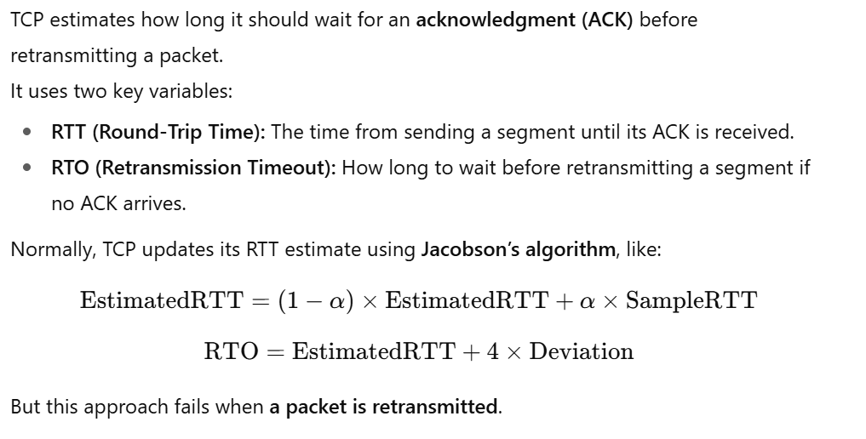

Flaw in RTO Calculation

Slide 22
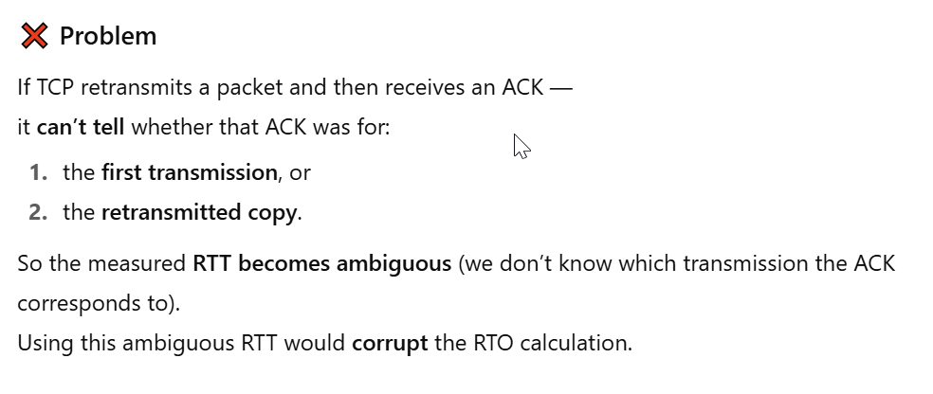




Flaw in RTO Calculation

Slide 23
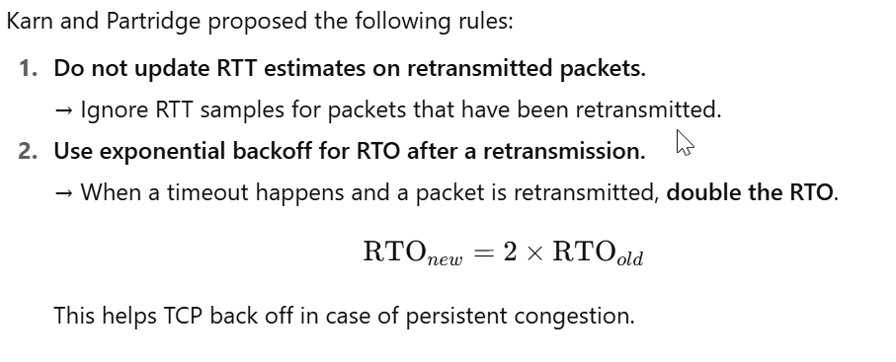


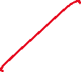

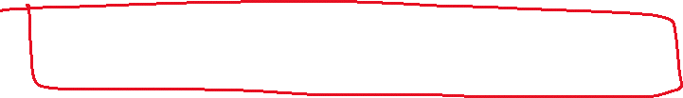


Karn’s Algorithm Solution

Slide 24

Karn’s Algorithm Solution
In practice, TCP caps the RTO — usually around 60 seconds (depending on implementation), so it doesn’t grow indefinitely.

Slide 25
Example 15.4
Figure 15.40 is a continuation of the previous example. There is retransmission and Karn’s algorithm is applied.
The first segment in the figure is sent, but lost. The RTO timer expires after 4.74 seconds. The segment is retransmitted and the timer is set to 9.48, twice the previous value of RTO. This time an ACK is received before the time-out. We wait until we send a new segment and receive the ACK for it before recalculating the RTO (Karn’s algorithm).
TCP/IP Protocol Suite
25
Notes:
25

Slide 26
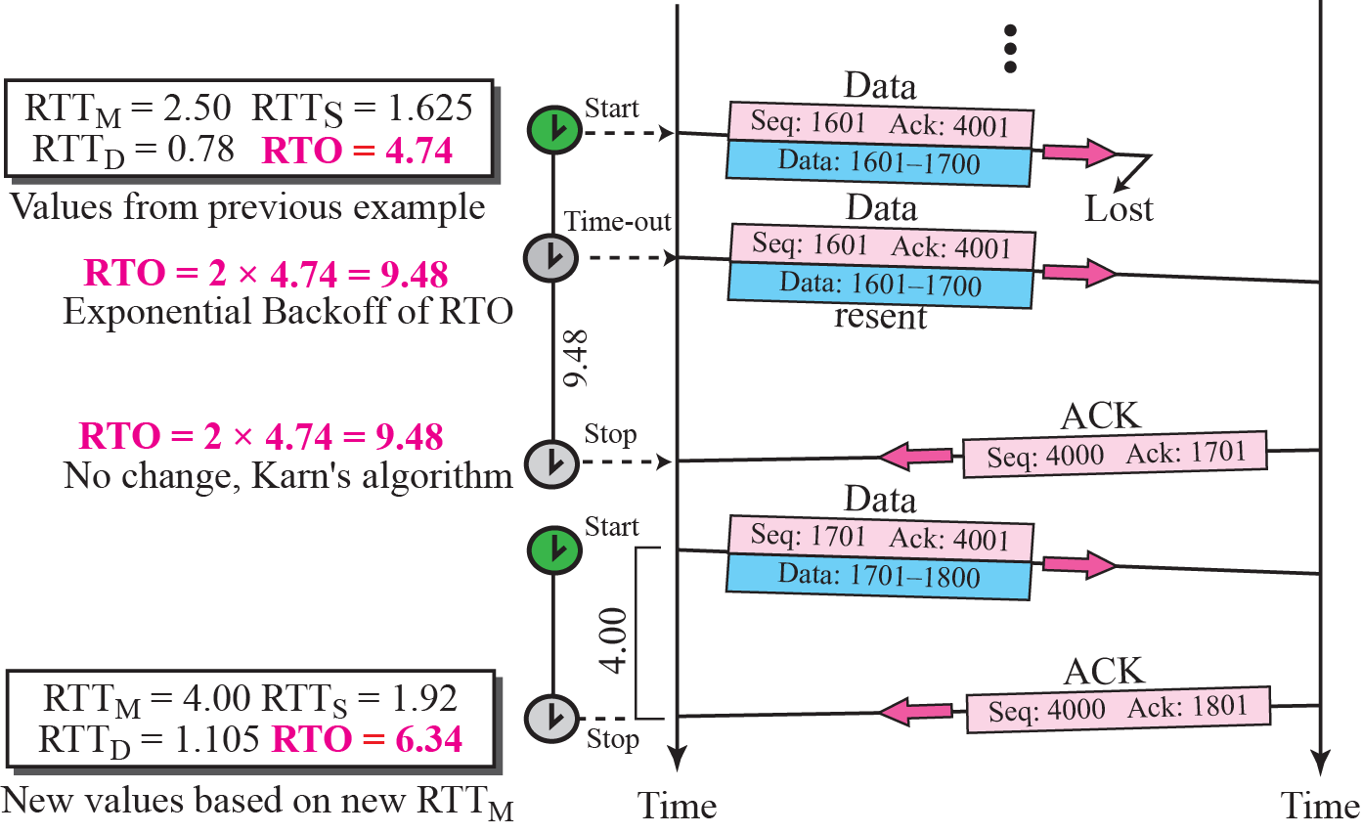



Figure 15.40 Example 15.4
TCP/IP Protocol Suite
26
Notes:
26

Slide 27

Persistence timer
To deal with the zero-size windows
What if the receiver advertises that the window size is ≠ 0 (by sending ACK) and this ACK is lost?
  ACK are not acknowledged in TCP
Start persistence timer
  when this goes off send a probe (1 byte of data)
  it is set to the retransmission time & doubled every time a response is not received (until 60s, then sent every 60s)

Slide 28

Keep alive timer
to prevent a long idle connection between a client and a server
  either client or server crash
usually set to 2h

Slide 29
Time-Waited Timer
used during connection termination to allow duplicate FIN segments to be discarded at the destination
usually 2 times the expected lifetime of a segment (MSL – maximum segment lifetime) typically 120 sec

Slide 30
Previous Year Question
2.c. In TCP, EstimatedRTT, DevRTT, and TimeoutInterval adapt to changing network conditions. Suppose that three successive SampleRTT measurements are recorded as 110 ms, 95 ms, and 120 ms. Given:
initial EstimatedRTT = 100 ms, initial DevRTT = 5 ms, α = 0.125, β = 0.25
Compute EstimatedRTT, DevRTT, and TCP TimeoutInterval after each SampleRTT.
Explain why it is not advisable to use the RTT of retransmitted packets when updating EstimatedRTT and TimeoutInterval. (14) [CO3]

